Slide 1


z
Pharmaceutical Sales Forecasting
Developed accurate sales forecasts for pharmaceutical products. Key steps are.
Data loading
Preprocessing
Model training
Forecasting
Evaluation
Insights
by Nishat Jillani

Slide 2
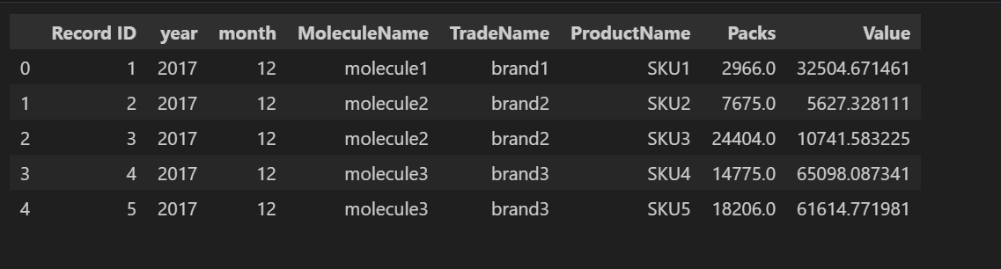
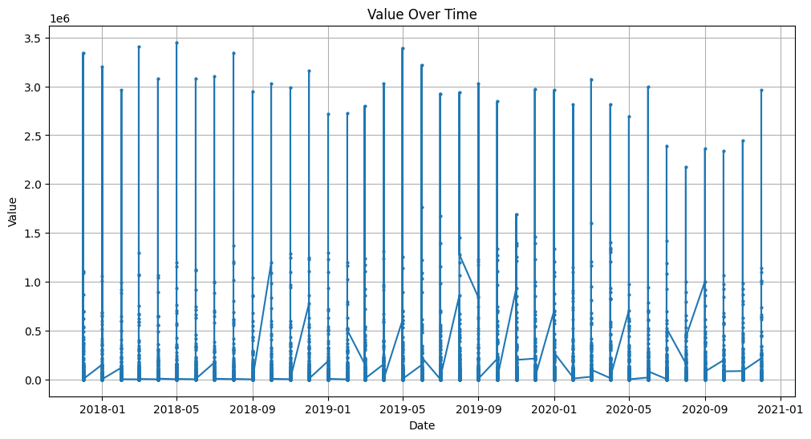
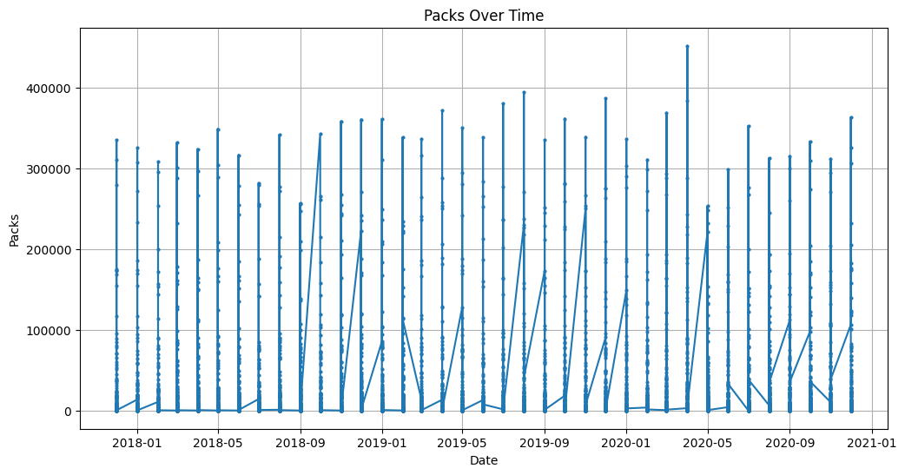
Data Loading and Preprocessing
1
Data Sources
Collect sales data and historical packs and values.
2
Handling Missing Values
Impute missing data to ensure dataset completeness.
3
Feature Creation
Generate lag features for time-series analysis.
4
Encoding Variables
Use Label Encoding for categorical data.

Slide 3




Model Training
Random Forest
Decision Tree
XGBoost
SARIMA
Ensemble learning method for classification and regression.
Tree-like model of decisions and their possible consequences.
Optimized distributed gradient boosting library.
Statistical method for time series forecasting.

Slide 4
Forecasting and Model Evaluation
Model
Performance
Random Forest
Stable, less variance
Decision Tree
More variability, potential overfitting
XGBoost
Captures seasonality and trends well
SARIMA
Best captures seasonality and trends

Slide 5
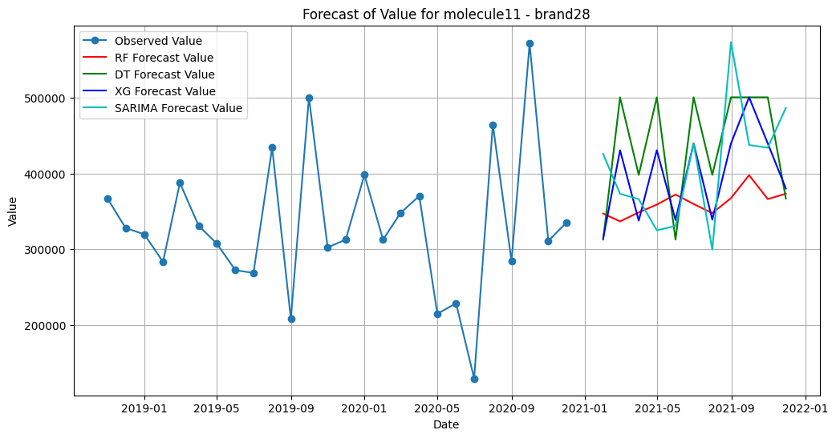
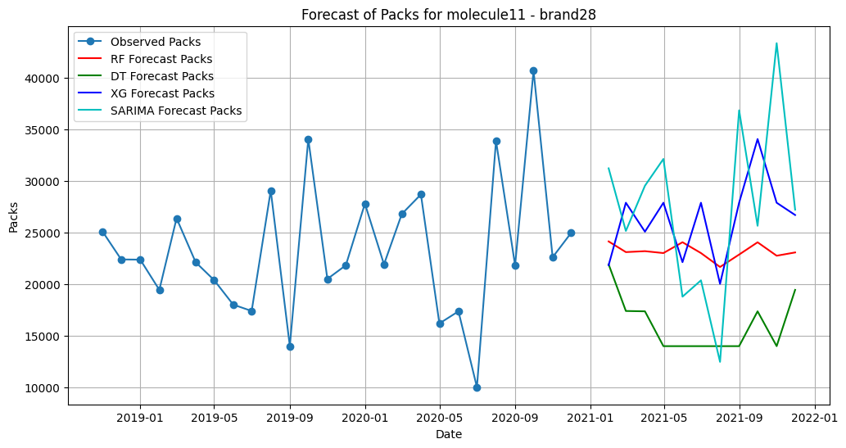
Combinations
I used combinations of "MoleculeName" and "TradeName" to
create more specific and accurate sales forecasts for each product pair.

Slide 6

Insights
1
Observed Values/Packs
2
Model Performance
Actual historical data trends provide baseline for comparison.
SARIMA outperforms other models in capturing seasonality and trends.
3
Forecast Accuracy
SARIMA provides the most accurate forecasts for sales.

Slide 7




Conclusion
Best Model Selection
SARIMA stands out as the most effective model.
Implementation
Implement SARIMA for future sales forecasting.
Further Exploration
We can further explore advanced models and techniques.

